Slide 1

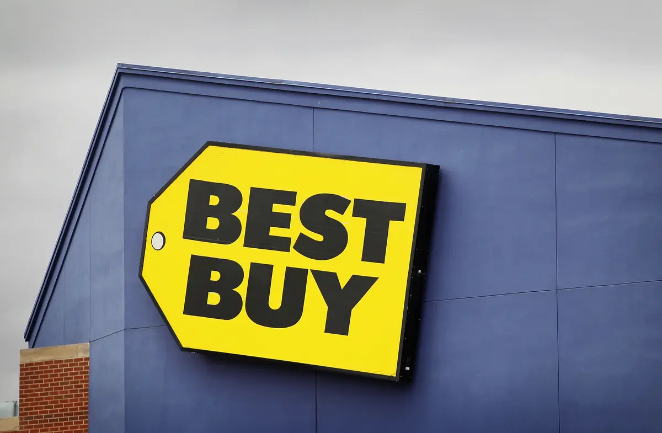
Sunday Loki
1
Group A: Bronx
Project: BestBuy

Slide 2

Software
Software is a set of instruction, data or programs used to operate computers and execute specific tasks.
System software is designed to run a computers software.
Unit communicate and works together.
Fast
Reliable
Cost Effective

Slide 3

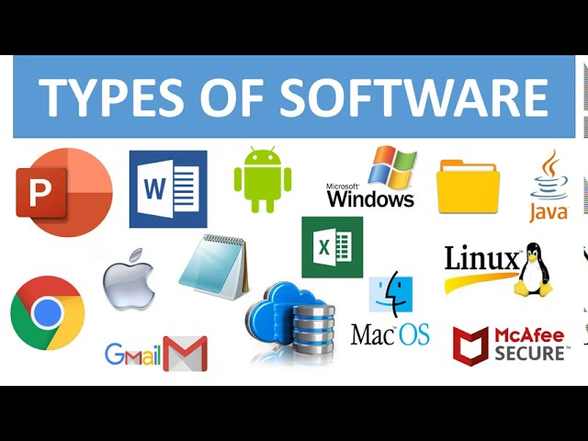
Types of Software
Systems Software: Utilities such as Windows, Mac OS
Desktop Application: MS Office, Adobe Photoshop
Client Server: Bank Teller systems, ATM Machines
Web Application: Bankofamerica.com, Ebay.com
Mobile Application: Uber, Lyft, WhatsApp

Slide 4
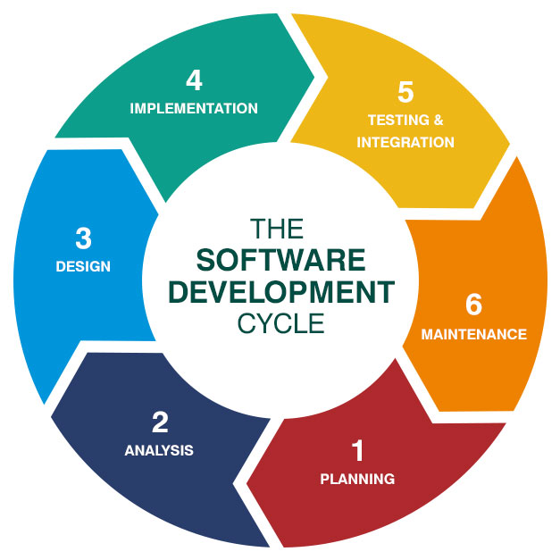
What is SDLC
The Software Development Life Cycle (SDLC) is a methodology with clearly defined processes for creating high-quality software. In detail, the SDLC methodology focuses on the following phases of software development:

Slide 5
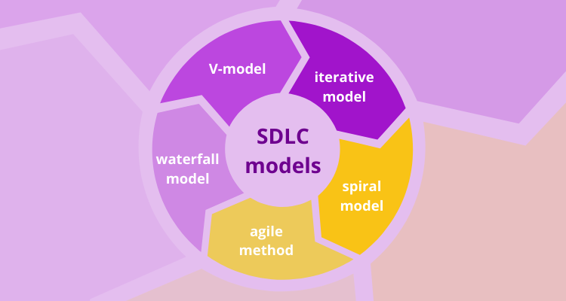
SDLC Methodologies
Most Popular 4 types:
Waterfall
Iterative
Agile
V-Model

Slide 6

Agile:
6
Agile methodology is a project management framework that breaks projects down into several dynamic phases, commonly known as sprints.
The Agile framework is an iterative methodologies.

Slide 7
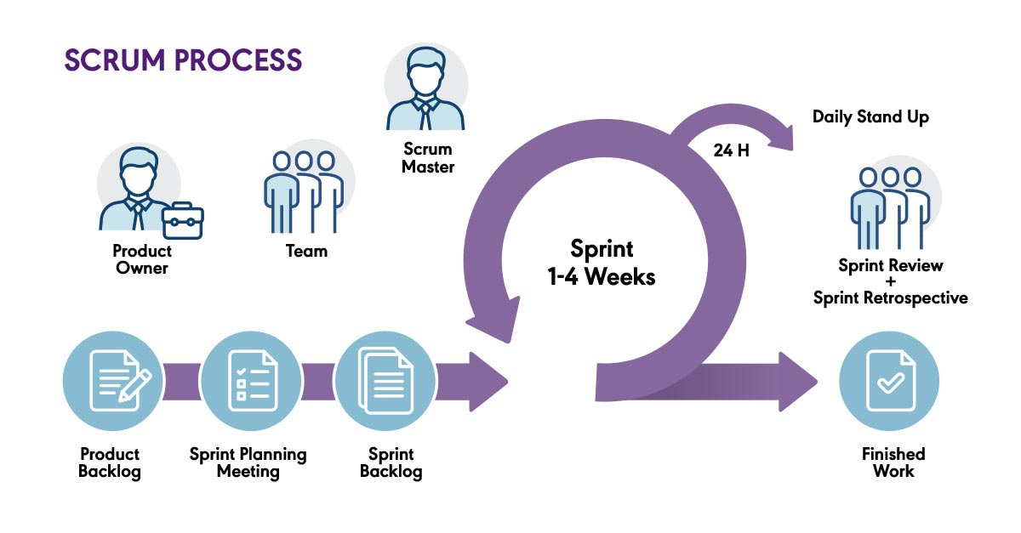
Scrum Process(Agile)
7

Slide 8
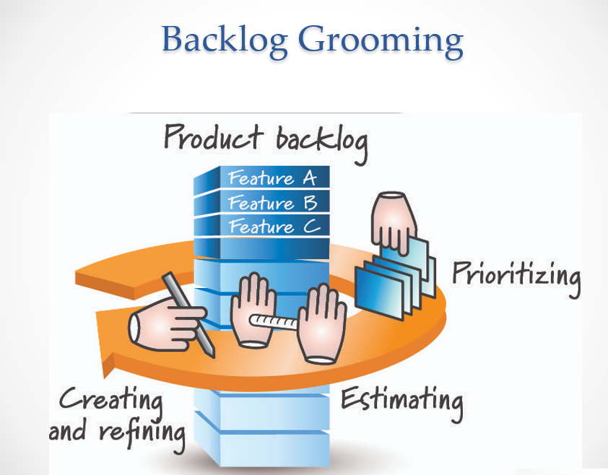
8

Slide 9
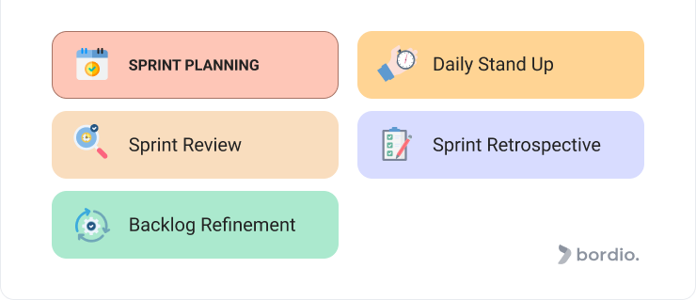
Sprint Ceremonies
9

Slide 10

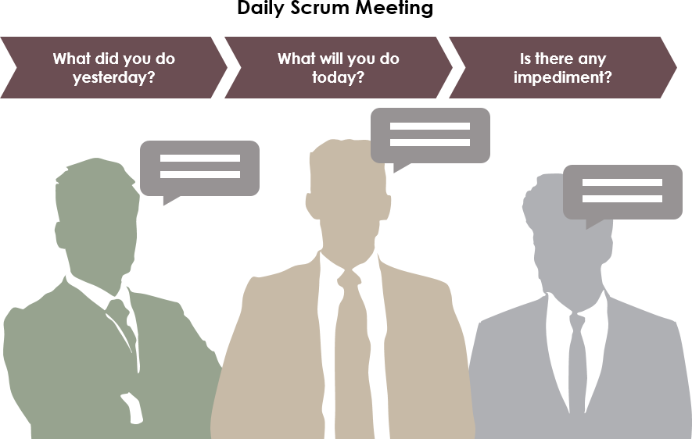



Daily Scrum
10

Slide 11
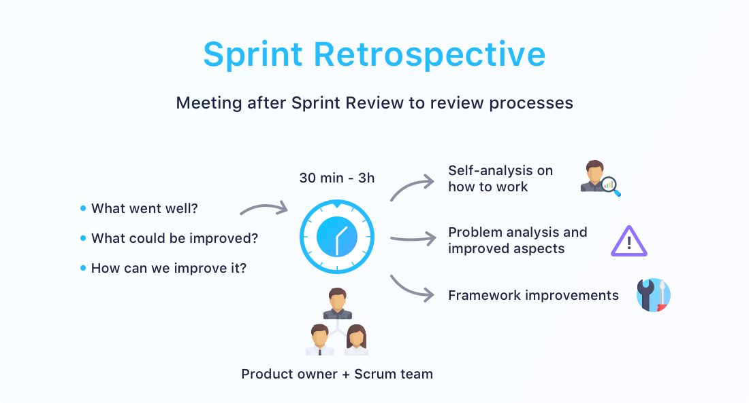
11

Slide 12
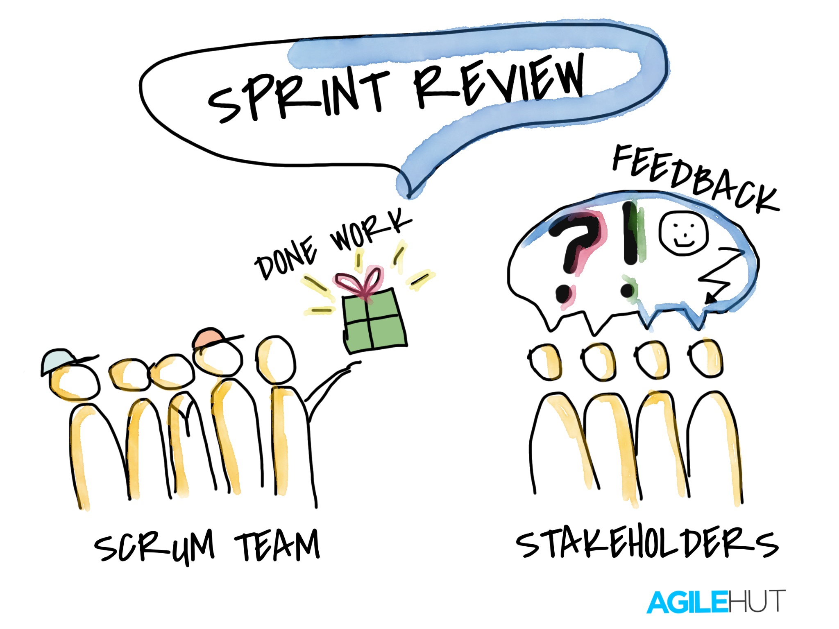
12

Slide 13
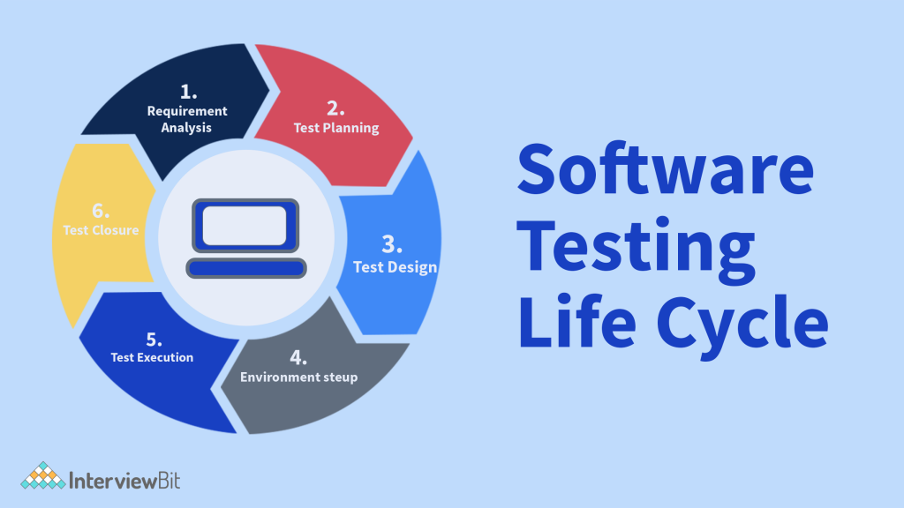
STLC
13
Software Testing Life Cycle (STLC) is a process used to test software and ensure that quality standards are met.

Slide 14

Software Quality
Quality software is reasonably bug-free, delivered on time and within budget, meets requirements and/or expectation, and is maintainable

Slide 15
Types of Quality Software
Quality Assurance: Prevention
Software Testing: Detection
Verification and Validation
Verification: Are we building the right product ?
Validation: Have we build the right product ?

Slide 16
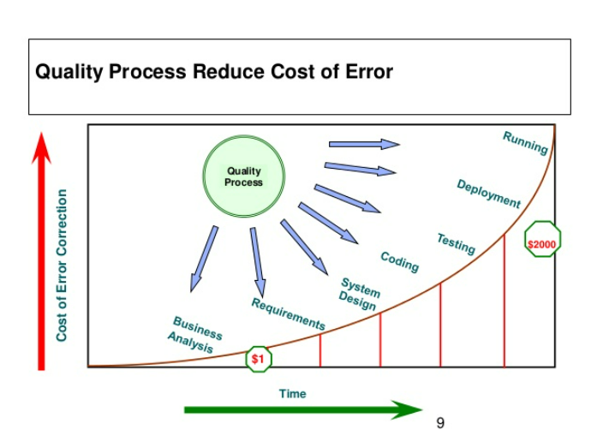
What & Why Software Testing
Software testing is the process of evaluating and verifying that a software product or application does what it is supposed to do. The benefits of testing include preventing bugs, reducing development costs and improving performance.

Slide 17
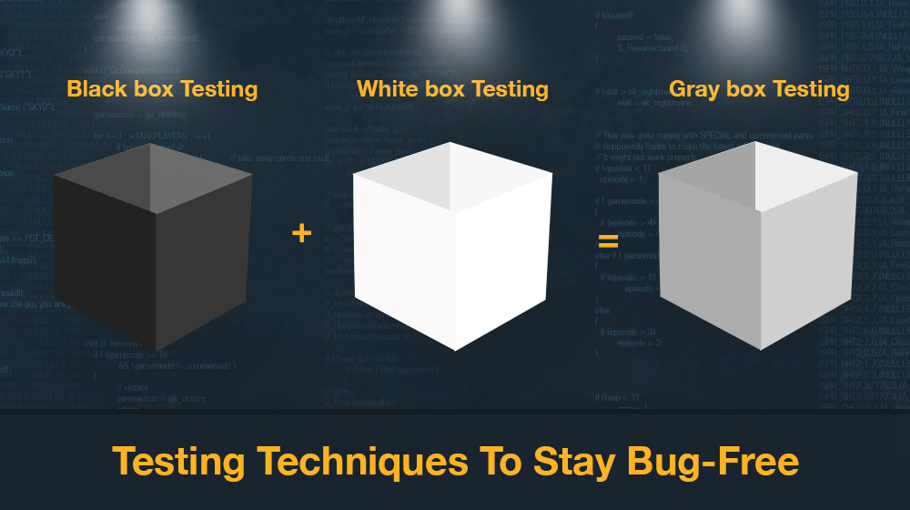
Type of Tester:
Black box: Black box testing is the Software testing method which is used to test the software without knowing the internal structure of code or program.
A QA uses Blackbox testing.
The code is not known while the functionality is known to the tester.
White box: White box testing is the software testing method in which internal structure is being known to the tester who is going to test the software.
A developer performs using the Whitebox.
Gray box: It is the combination of White and Blackbox testing. For example, when calling someone, the call is received in second. Behind the scene, nothing is known to the people. The routing, connecting and data is not seen by the caller. This is known as Gray box testing.
Hotelbooking: While the reservation is shown but the data base is not shown by the receivers.

Slide 18
Type of Testing:
18
Smoke Testing: Smoking testing only handle major functionality of the Application.
For Example, Major Functionality Resister, log in log out,
Functional Testing: Functional testing basically in an application you will be introduce new functionality in your application.
Functional testing focuses on the followings:
Positive—Positive testing is your Expectation is positive, you provide your valid email and valid password it should be successfully log in your account .
Negative and— Negative Testing is your Expectation is negative, you provide your valid email and invalid password it should not log in your account.
Boundary Scenarios—minimum and maximum characteristics

Slide 19
Type of Testing:
Regression Testing: Regression testing is nothing but handle existing functionality which is already built earlier people are using it just to check if it is working properly.
Non-Functional Testing: In simple words, how well the system performs is non-functionality testing. Non-functional testing refers to various aspects of the software such as performance, load, stress, scalability, security, compatibility etc., Main focus is to improve the user experience on how fast the system responds to a request.
19

Slide 20
Level of Testing: There are 4 type of level of Testing .Which is are blow. Unit Testing :The developer focuses on each of the tasks. It is a small module and follows each task to make sure it functions properly.
integration testing: is two or three modules, and we see that both interconnecting properly or not.
Example: online shopping, you choose the cloth>adding on bags>checking out>payment>shipping address>checkout
20

Slide 21
Level of Testing
21
System Testing : is the whole application or whole product end to end whether it is properly working or not.
UAT testing: It is the final stage before launching the product. The end user makes sure the software runs smoothly which is called user acceptance.

Slide 22
Software Test Lifecycle Activities
22
What is STLC: Software testing life cycle is a sequential flow of various testing processes that are to be executed to ensure maximum results from software testing. STLC ensures that all the testing processes are carried out in an orderly and planned manner. We have understood that STLC is a process,

Slide 23
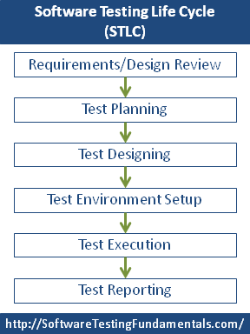
23
Now look at the different steps involved in this process:

Slide 24
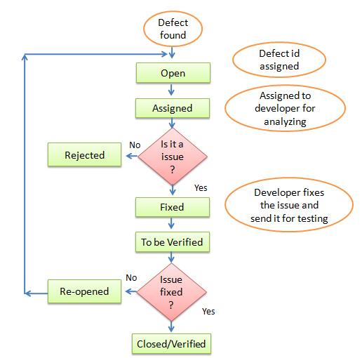
Defect life cycle
24
Bug life cycle also knows as defect life cycle.
In software devolepment
Proccess the bug has a life cycle.
The bug should go through the life cycle to be close.
Bug can be definesd as the abnormal behavior of the software.Bug start when defect is found & end a defect is closed.
After ensuring it is not reproduced.
Now we can see different state of Defect life cycle.

Slide 25
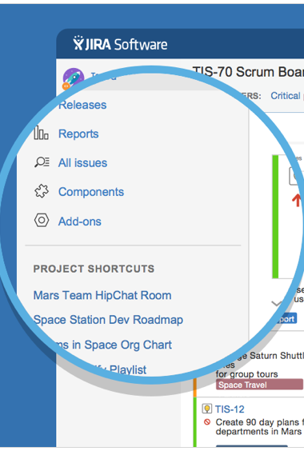
Jira:
25
What is Jira and why it is used?
JIRA is a bug tracking tool that allows software developers to plan, track and work faster. JIRA is the main source of information for future software release. Developers can plan new features to be added and bugs to be fixed in the next release.
•Organize Documentation Tasks
•Track Documentation Progress
•Helps Meet Deadlines
•Provides Faster Feedback
•Integration Available with third-party software

Slide 26
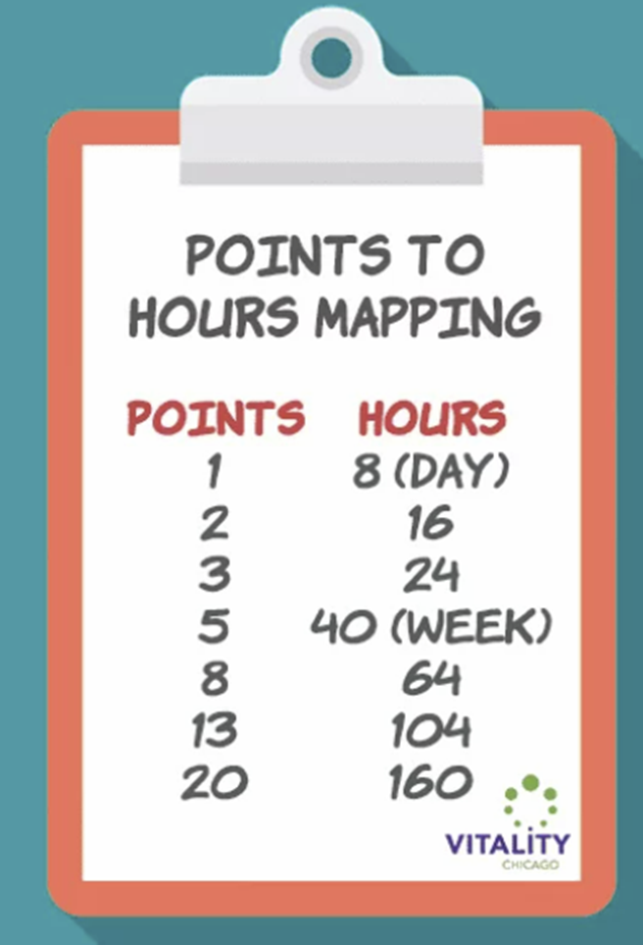
26
Story Point (Fibonacci Sequence )

Slide 27
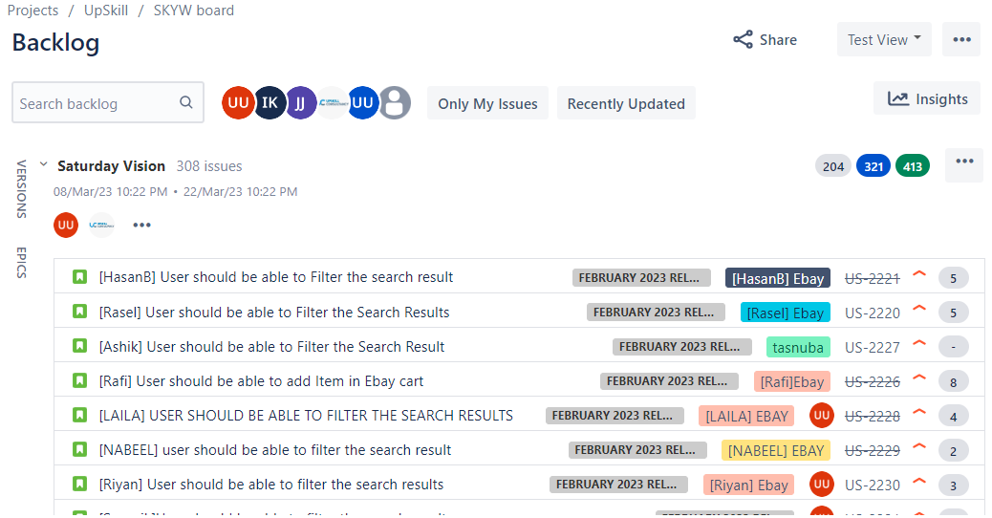
Backlog In Jira

Slide 28
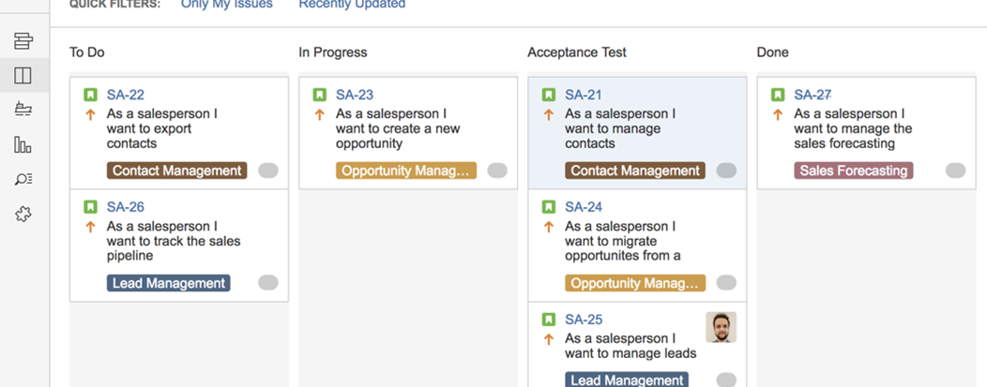
Active Sprint

Slide 29
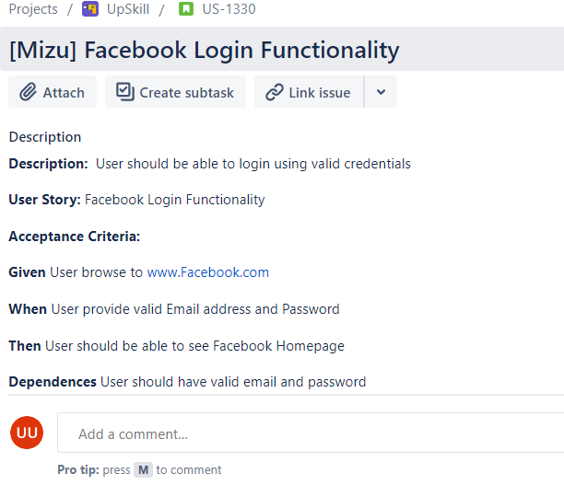
Test Case (Example)

Slide 30
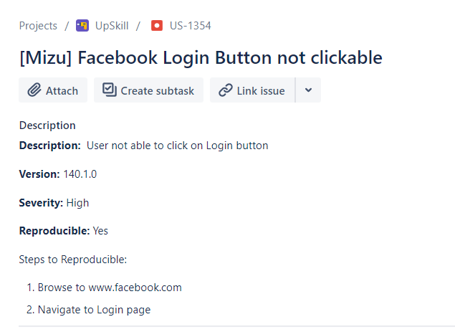
Defect/ Bug

Slide 31

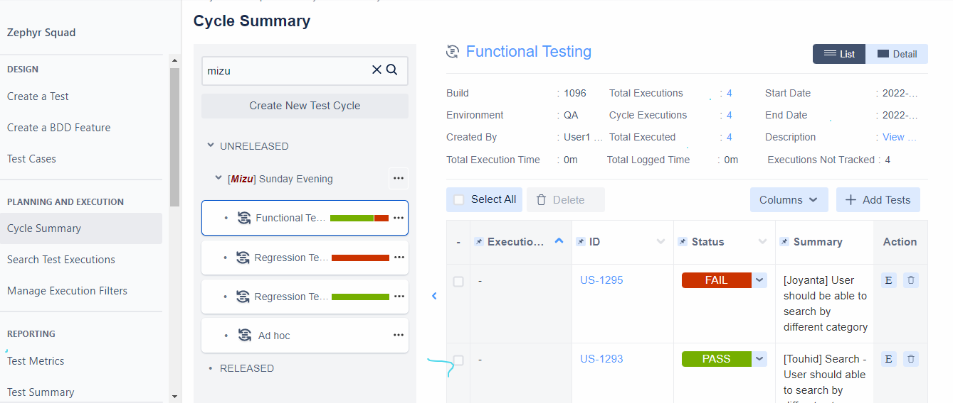
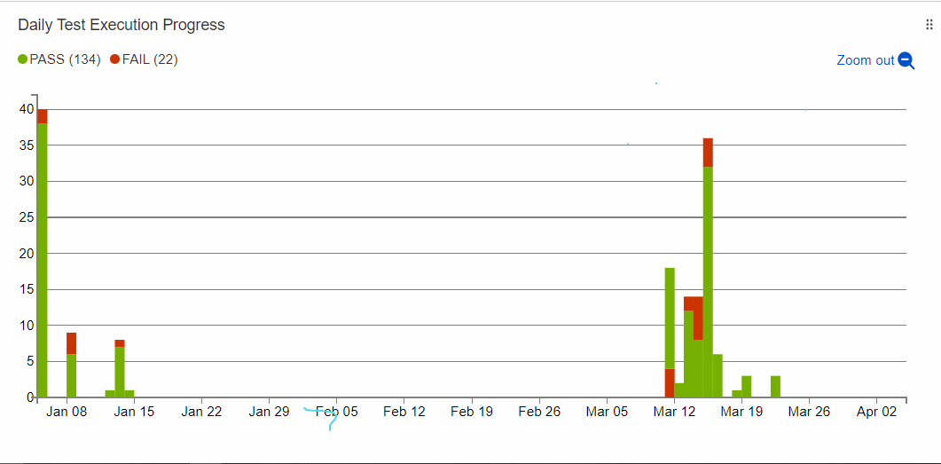



Zephyr

Slide 32
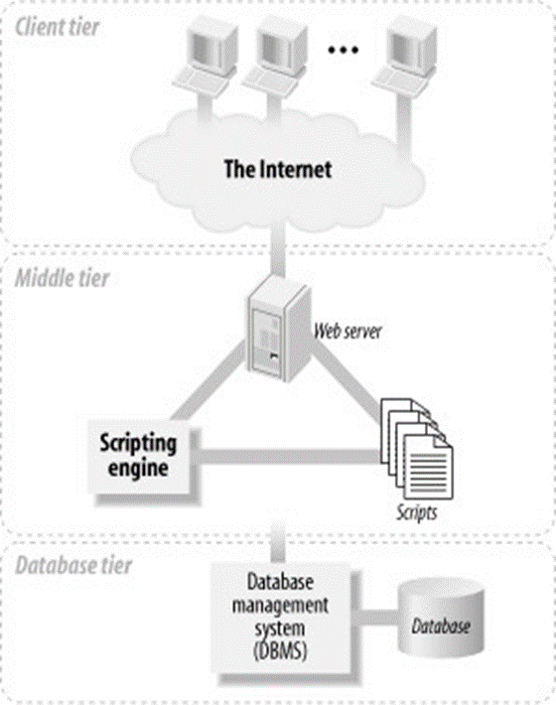
Database & SQL

Slide 33
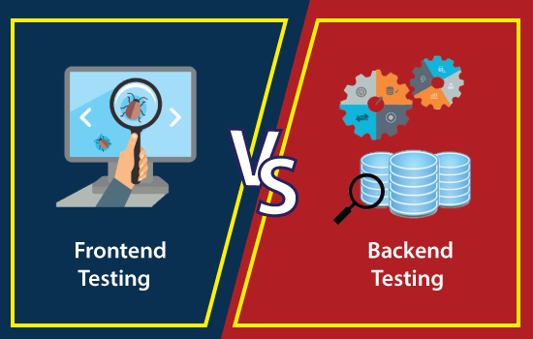

Slide 34
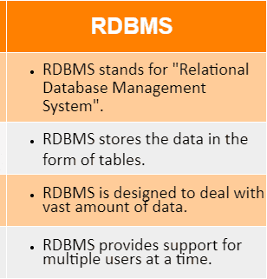
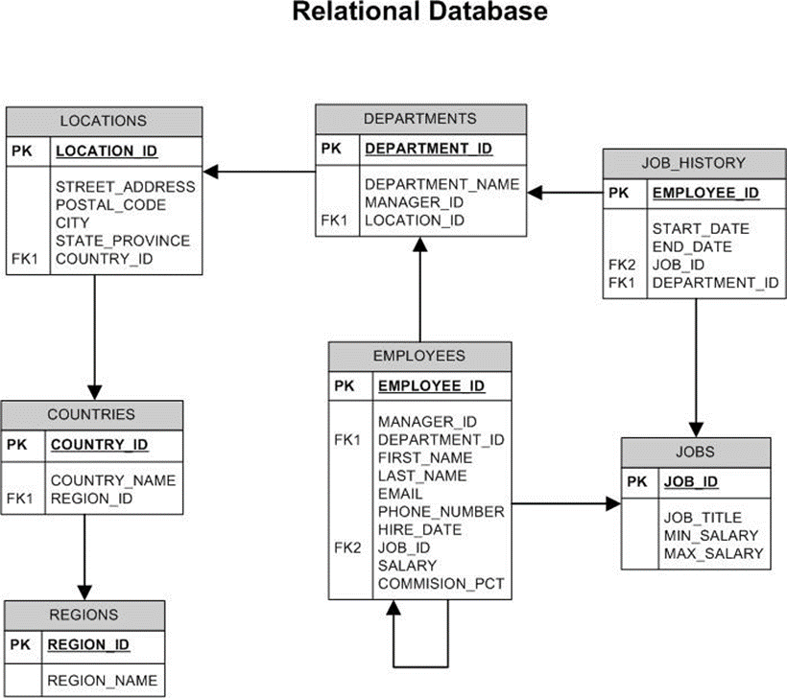
34

Slide 35
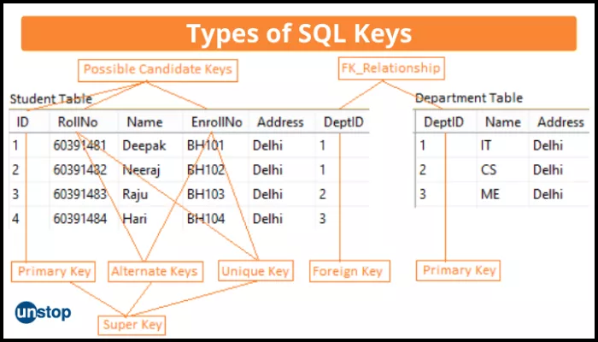
Table Keys

Slide 36
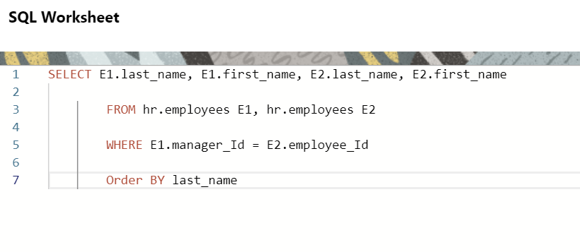
SQL

Slide 37
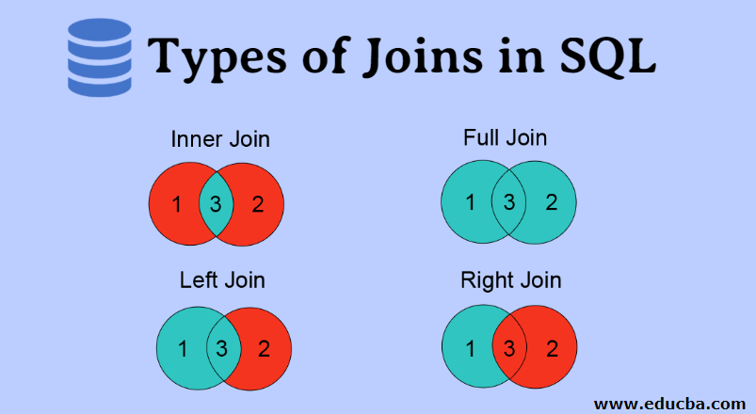

Slide 38
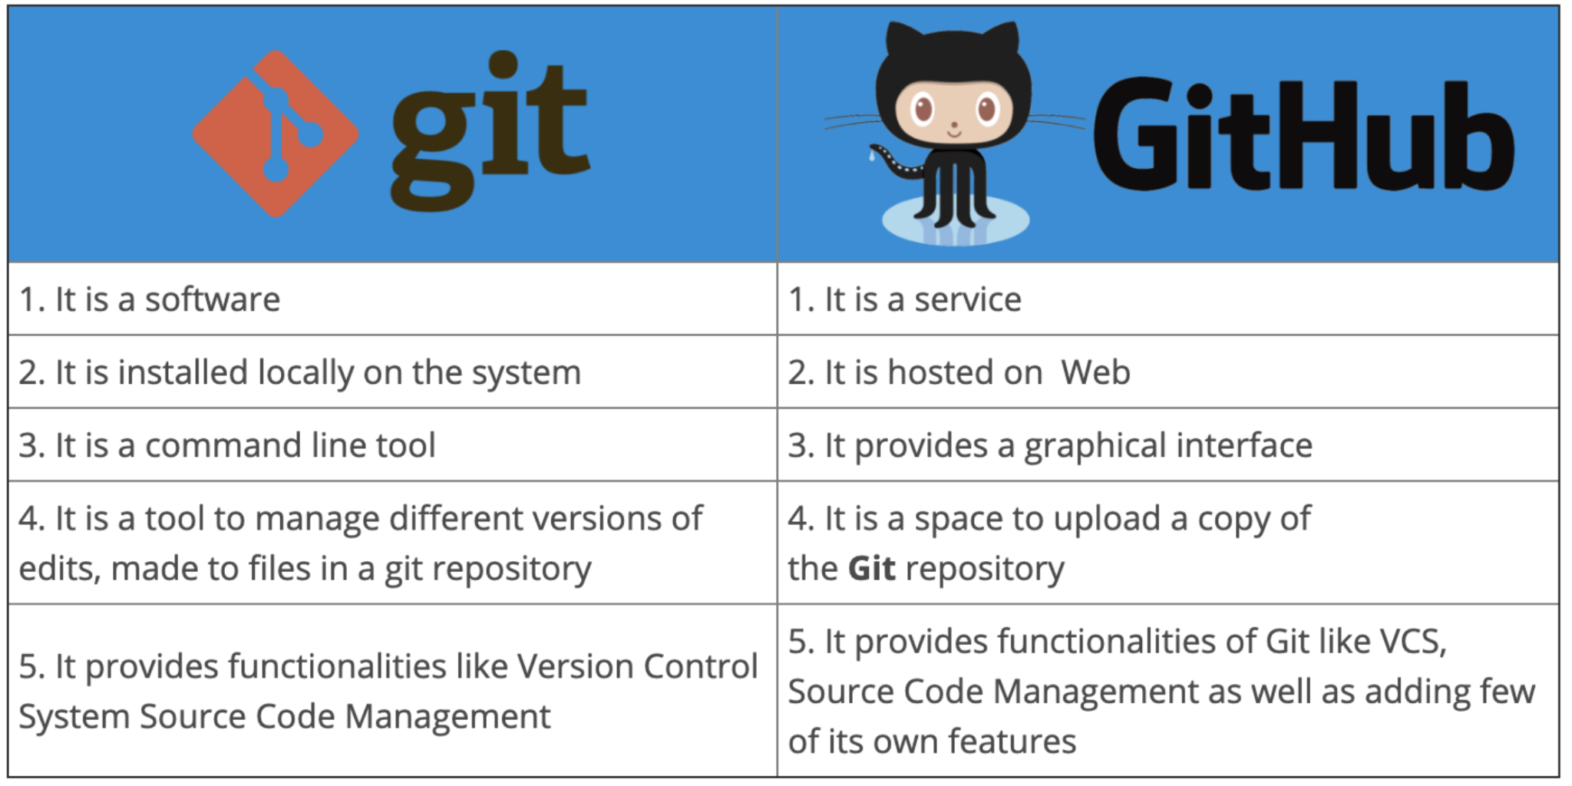

Slide 39
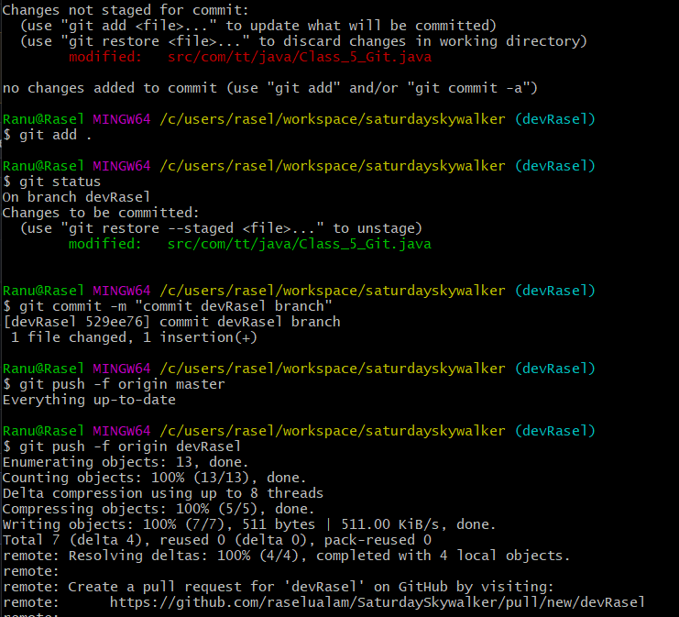
Git

Slide 40
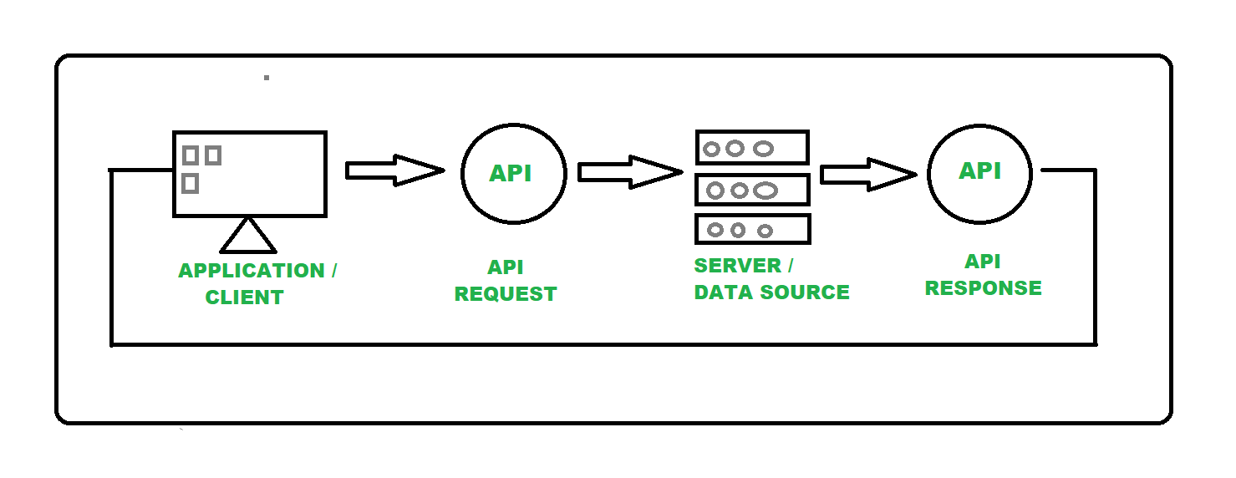
API

Slide 41
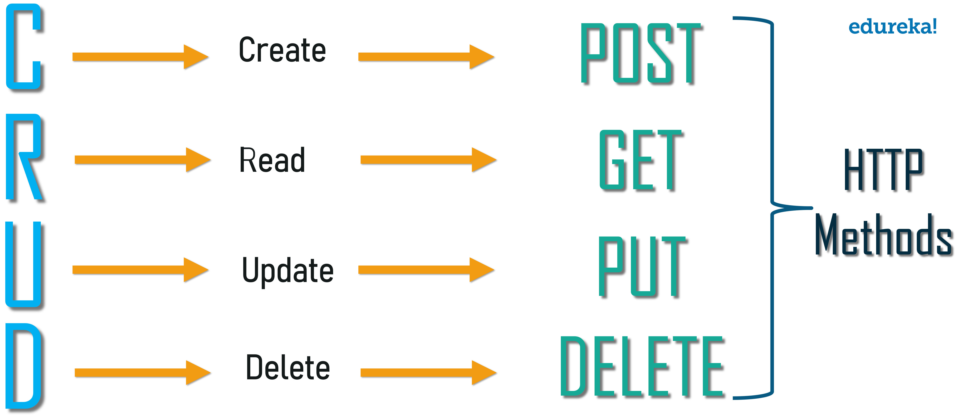








Slide 42
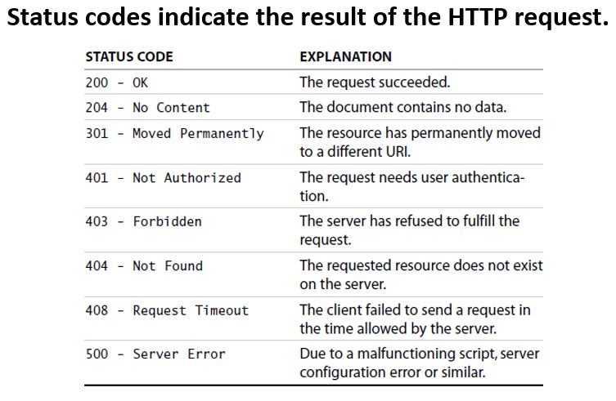






Slide 43
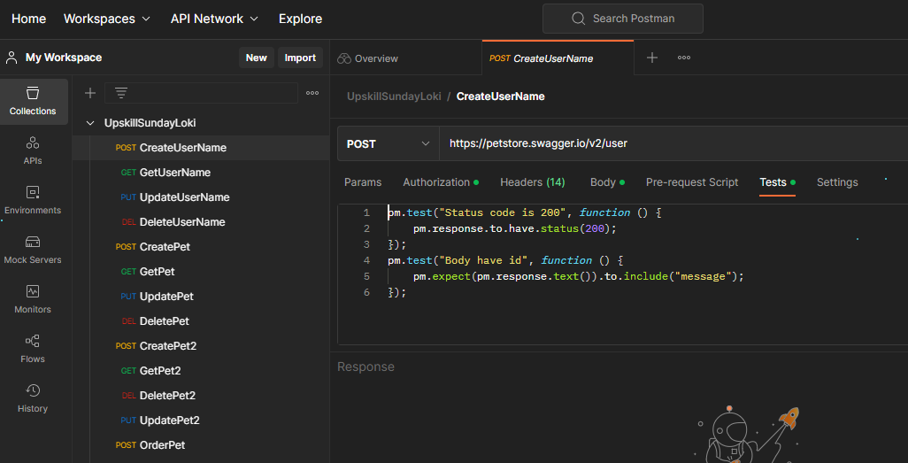
Postman Swagger
43

Slide 44
PACKAGE
BASIC STRUCTURE OF JAVA
CLASS
44
MAIN HOUSE
ROOM
ROOM
BOUNDARY
OF
METHOD
METHOD
ROOM
ROOM
METHOD
METHOD
THE HOUSE

Slide 45
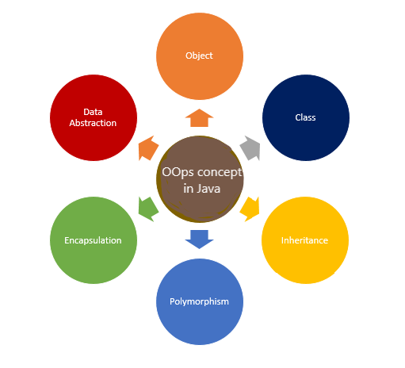
Java
OOP’S Concept
Notes:
Java OOP concepts let us create working methods and variables, then re-use all or part of them without compromising security
Object-Oriented Programming

Slide 46
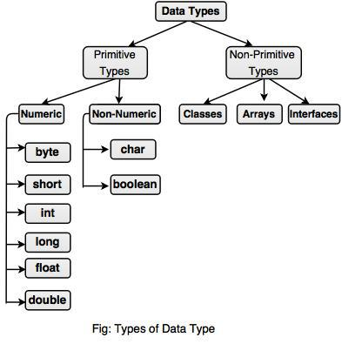
46
DATATYPES IN JAVA

Slide 47
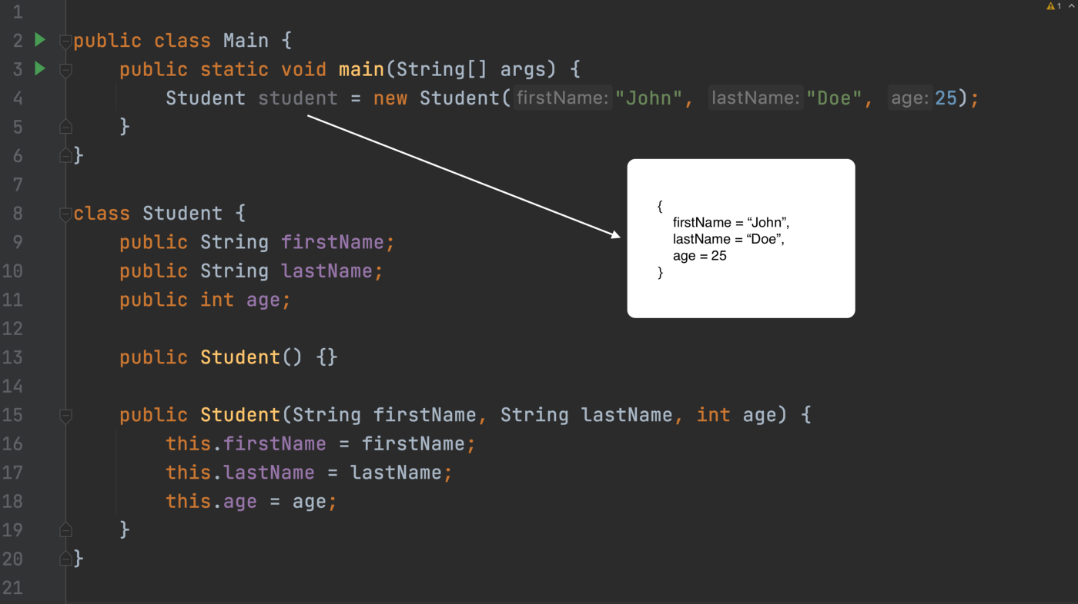
OBJECT _ (JAVA)
Notes:
instance of a java class

Slide 48
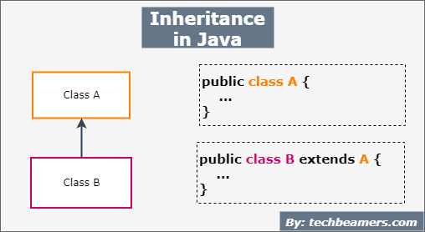
INHERITANCE _ (JAVA)
48
Notes:
acquires the properties from one class to other classes

Slide 49
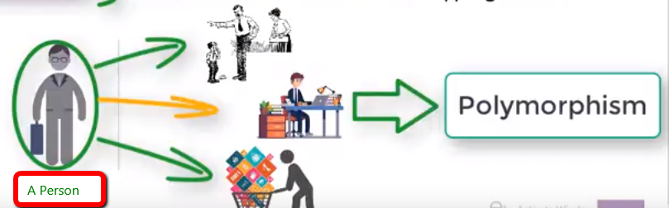
POLYMOPHISM _ (JAVA)
Notes:
the ability of an object to take many form

Slide 50
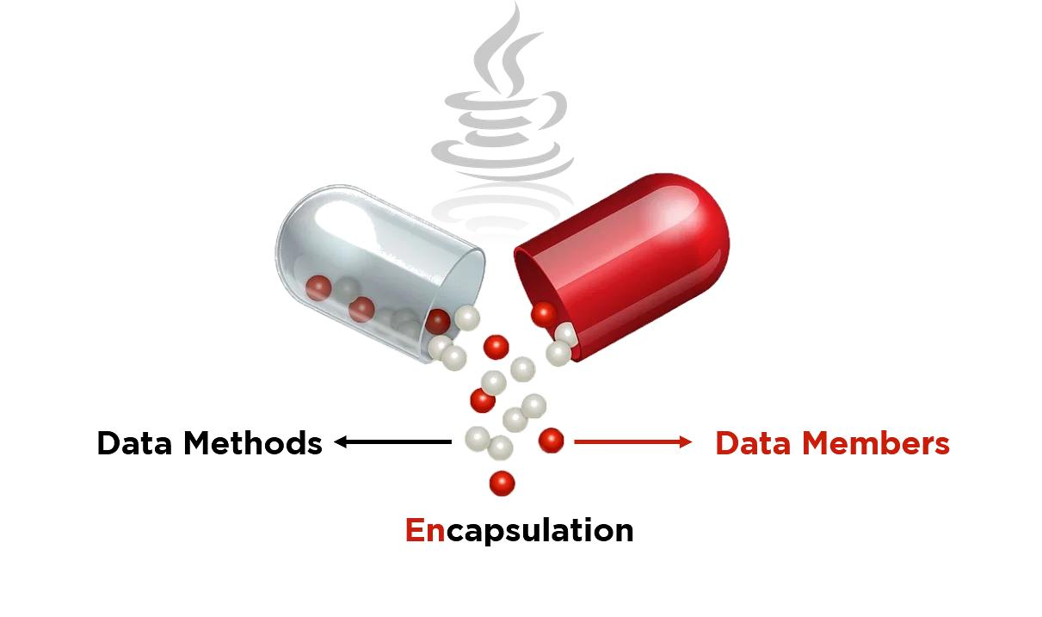
ENCAPSULATION _ (JAVA)
Notes:
hiding the data with setter and getter method (to get the data)

Slide 51
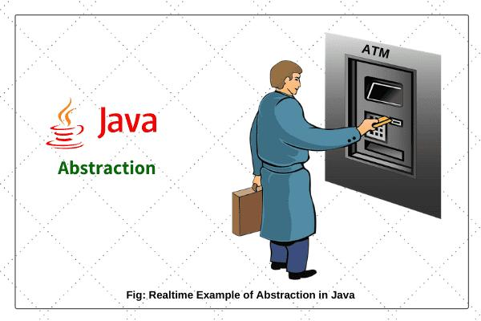
ABSTRACT CLASS (JAVA)
Notes:
access modify = public , private , protected
Data abstraction is the process of hiding certain details and showing only essential information to the user

Slide 52
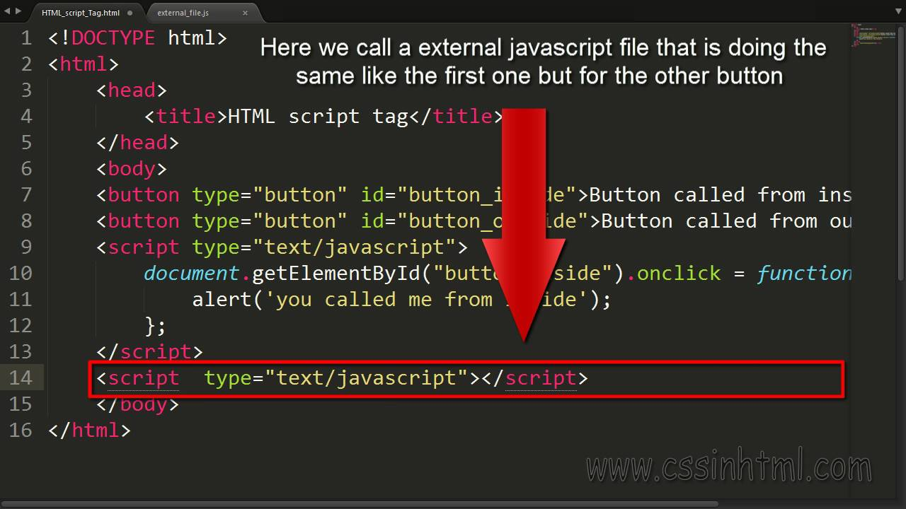
HTML
52

Slide 53
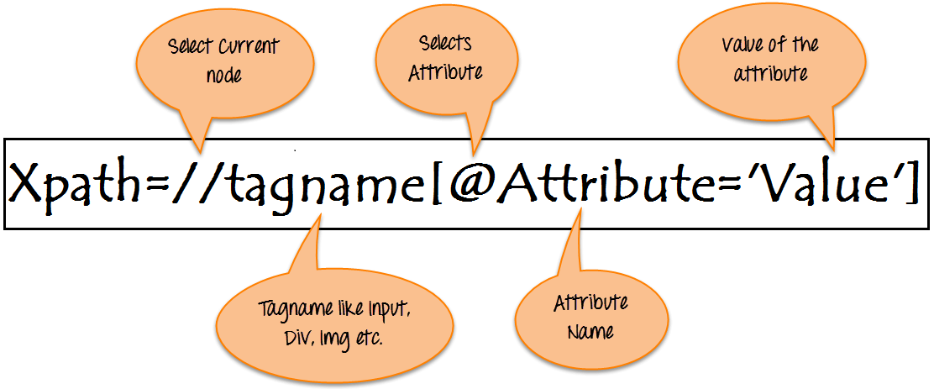
Xpath
53

Slide 54
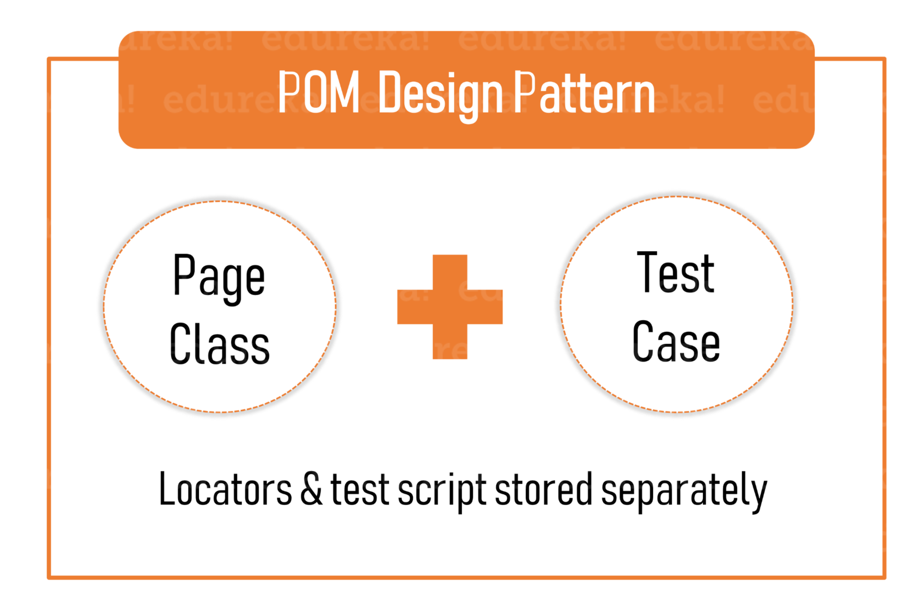
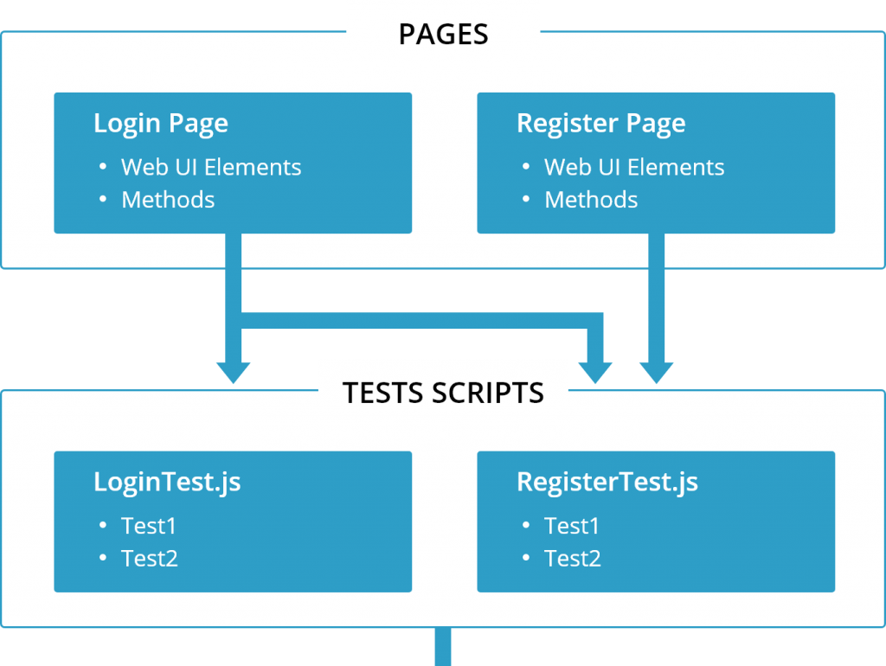
PAGE OBJECT MODEL
Notes:
for separate web page, we have separate class
approach for design pattern and it helps separating page object and script

Slide 55
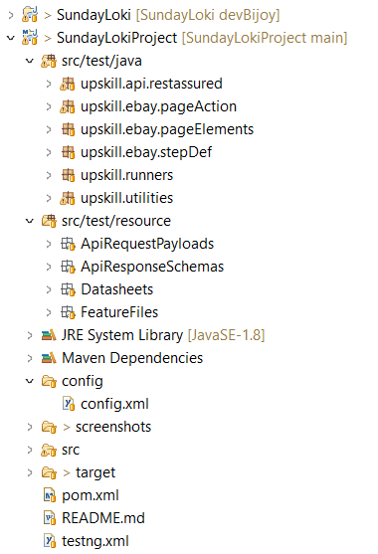
FRAMEWORK SKELETON

Slide 56

PAGE OBJECT MODEL
ACTION CLASS
HOW
POM WORKS
ELEMENTS/ LOCATOR CLASS
STEP DEFINATION CLASS
FEATURE FILES

Slide 57
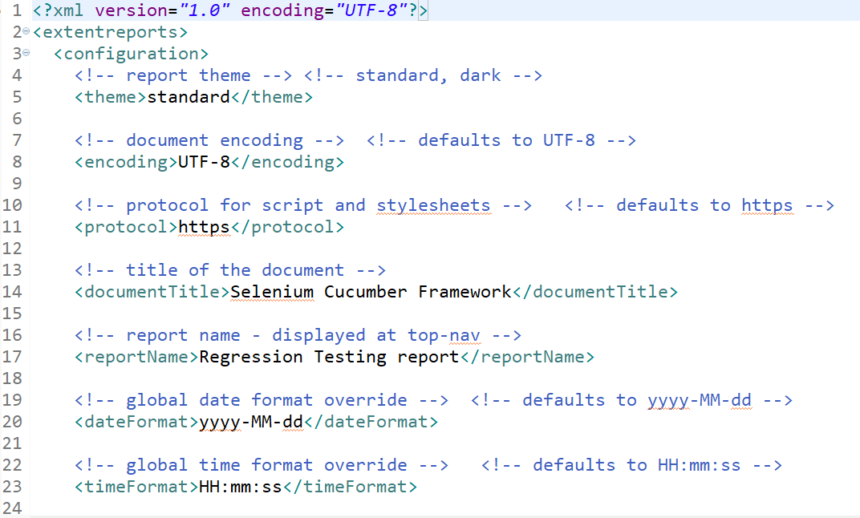
57
CONFIG.XML

Slide 58
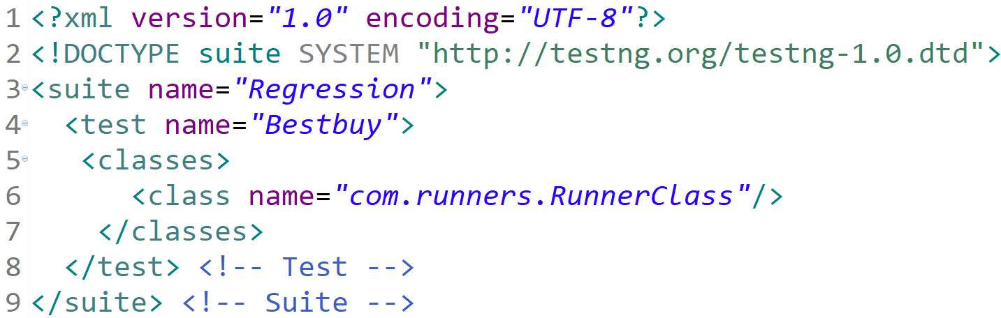
TESTNG.XML
58

Slide 59

AFTER ACTION CLASS
In Selenium, after actions are a set of actions that are performed after a test has been executed. These actions are used to perform various cleanup tasks such as closing browser windows, deleting temporary files, logging out of the application, and resetting the application's state to its original state.
Notes:
print out the test pass once all the steps from feature file runs

Slide 60

Feature File
What is feature files:
Feature File – It servers as an entry point to the Cucumber tests. It is the file where your test scenarios are written in Gherkin language. A Feature file may contain single or multiple test scenarios.

Slide 61

Steps in selenium
61
In Cucumber, a step definition is a piece of code that maps a specific step in a scenario to an action that should be taken by the automation framework.
By creating step definitions for each step in a scenario, you can build up a set of reusable components that can be used to test different scenarios.

Slide 62

Locators in selenium
62
A locator in Selenium is a way to identify a specific element on a web page, such as a button, link, text box, or dropdown. Locators are used by Selenium to find and interact with these elements as part of test automation.
There are several types of locators that can be used in Selenium, including:

Slide 63




Data Excel Sheet
63
To read data from an Excel sheet in Selenium, you can use a Java library called Apache POI. Here's an example of how to read data from an Excel sheet using Selenium WebDriver and Apache POI:
Create an Excel file with data that you want to read. For example, create a file called "TestData.xlsx" with the following data:
Use
Apache
POI to Integrate Excel Sheet
Username | Password
user1 | pass1
user2 | pass2
user3 | pass3

Slide 64

RUNNER CLASS
Notes:
runner class we GLUE the feature file with the Step Definition class where i call the common method from Page Action class in the step definition

Slide 65

Before Action Class
Before Action will run before
executing any scenario..
Notes:
framework we develop utilities such as ……. run the feature file before any action (dry run)

Slide 66

Setup Driver Class
66
Use the driver instance to interact with the browser and automate tests.
When you're finished with the driver, remember to close it:
Notes:
set up the web driver from the cloud

Slide 67

Dry Run (Snippet)

Slide 68

Regular Run

Slide 69


Regression Testing Report
BESTBUY

Slide 70

This Photo by Unknown author is licensed under CC BY-SA.

